Slide 1

SNAP PARK
IES UA-2023/24
108546: Tiago Pereira
108298: Diogo Machado Marto
107186: Vítor Santos
73259: Diogo Gaitas

Slide 2

Objectives
Develop a software product specification, from its usage requirements/scenarios (user stories) to its technical design.
Propose, justify and implement a software architecture, based on enterprise frameworks.
Put collaborative work practices for code development and agile project management into practice.

Slide 3
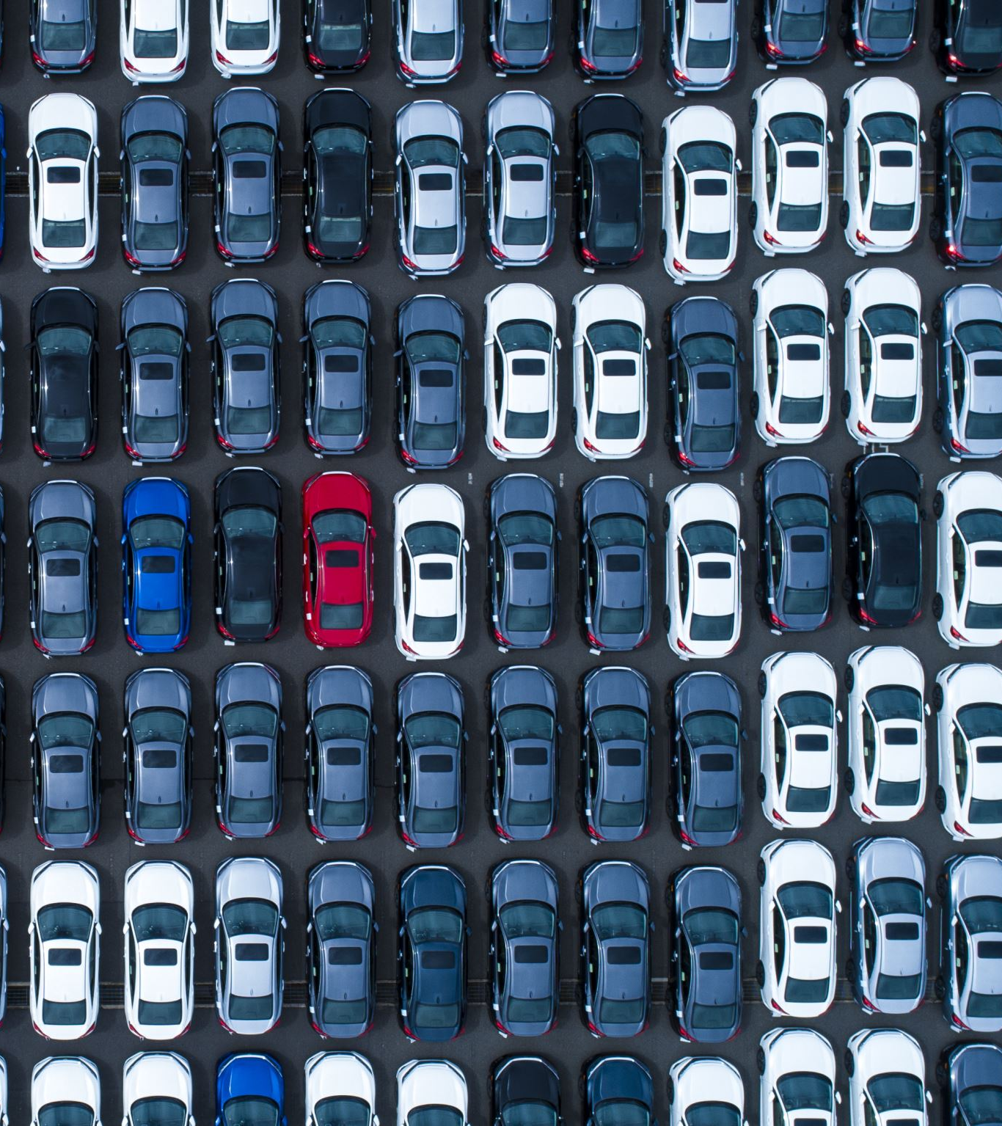
Product concept
App designed with parking lot owners in mind. It aims to provide them with several monitoring and managing features, including essential information such as the number of parked vehicles.

Slide 4
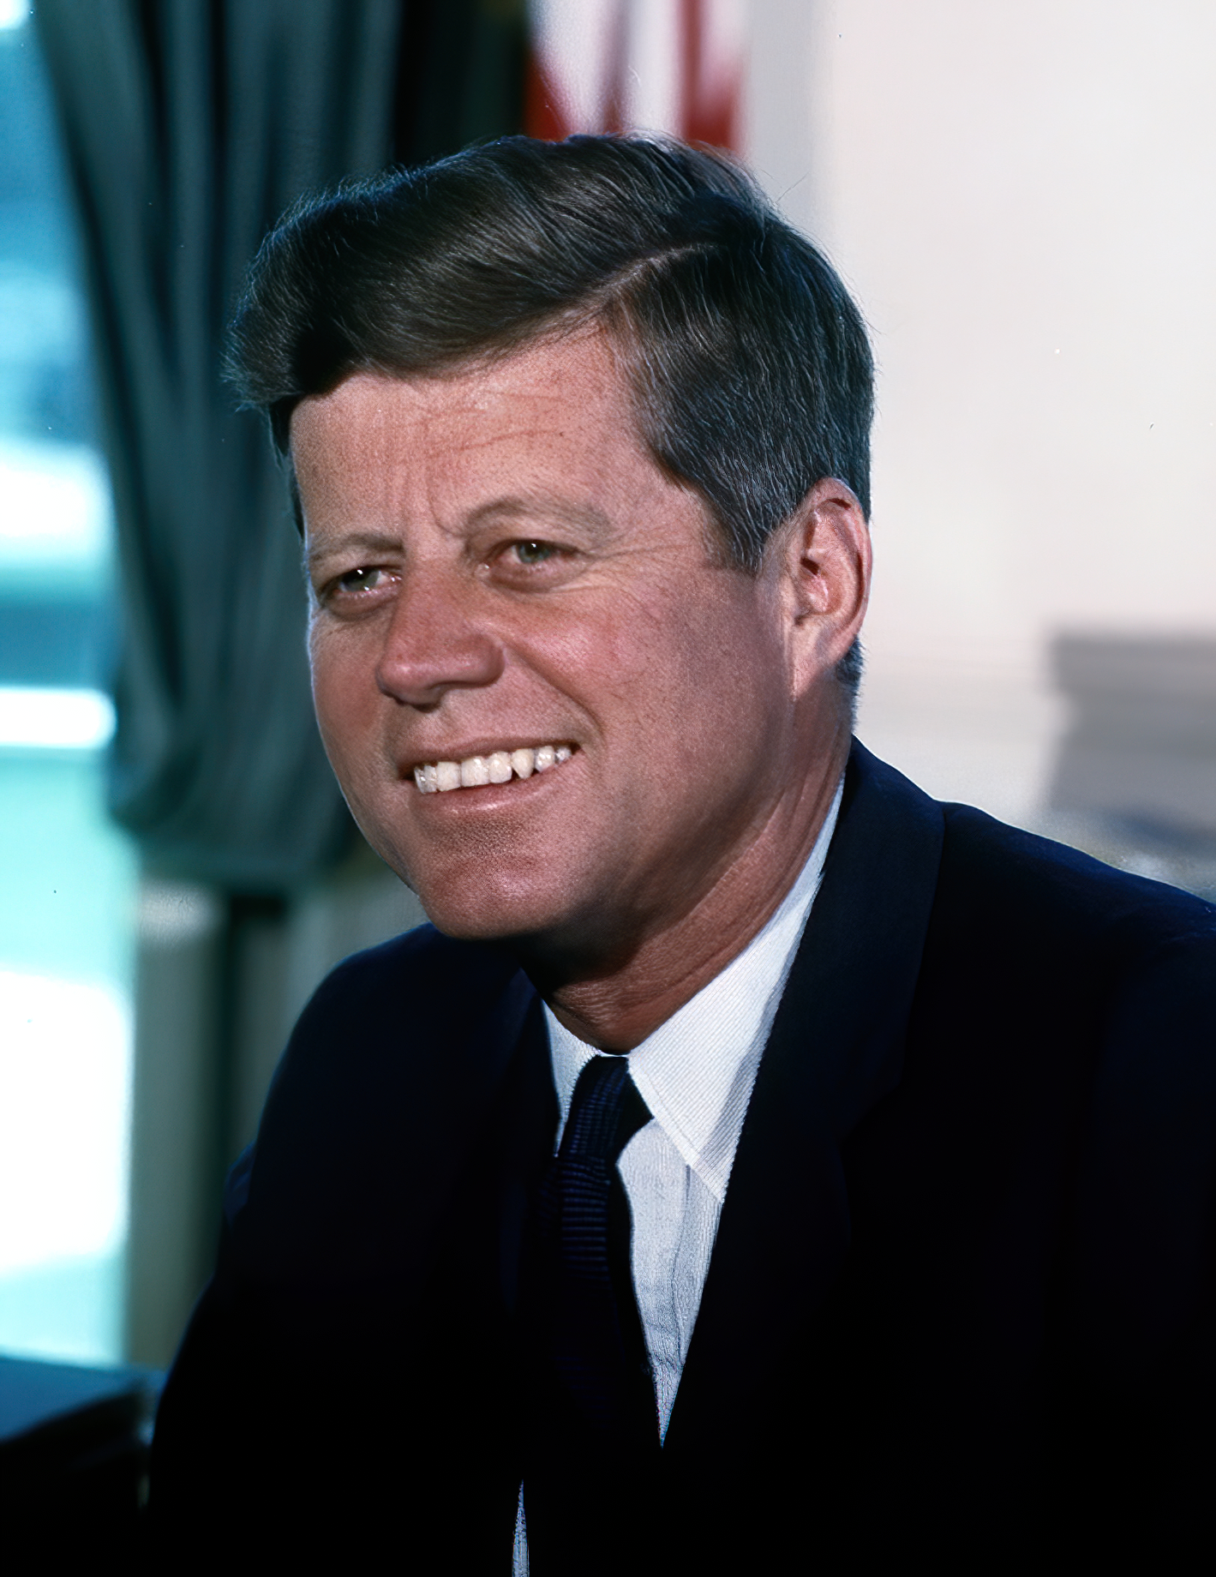
Personas
John is a forty-year-old Portuguese owner of a moderately-sized general store that recently acquired the nearest parking lot, being immediately next to the store.

Slide 5
User stories
Register park epic
John should be able to add a park
John wants to add a sensor to a park

Slide 6
User stories
Monitor park epic
John should be able to monitor park movement
John wants to monitor air quality
John should be able to check revenue
John should be able to view the light levels of a park

Slide 7
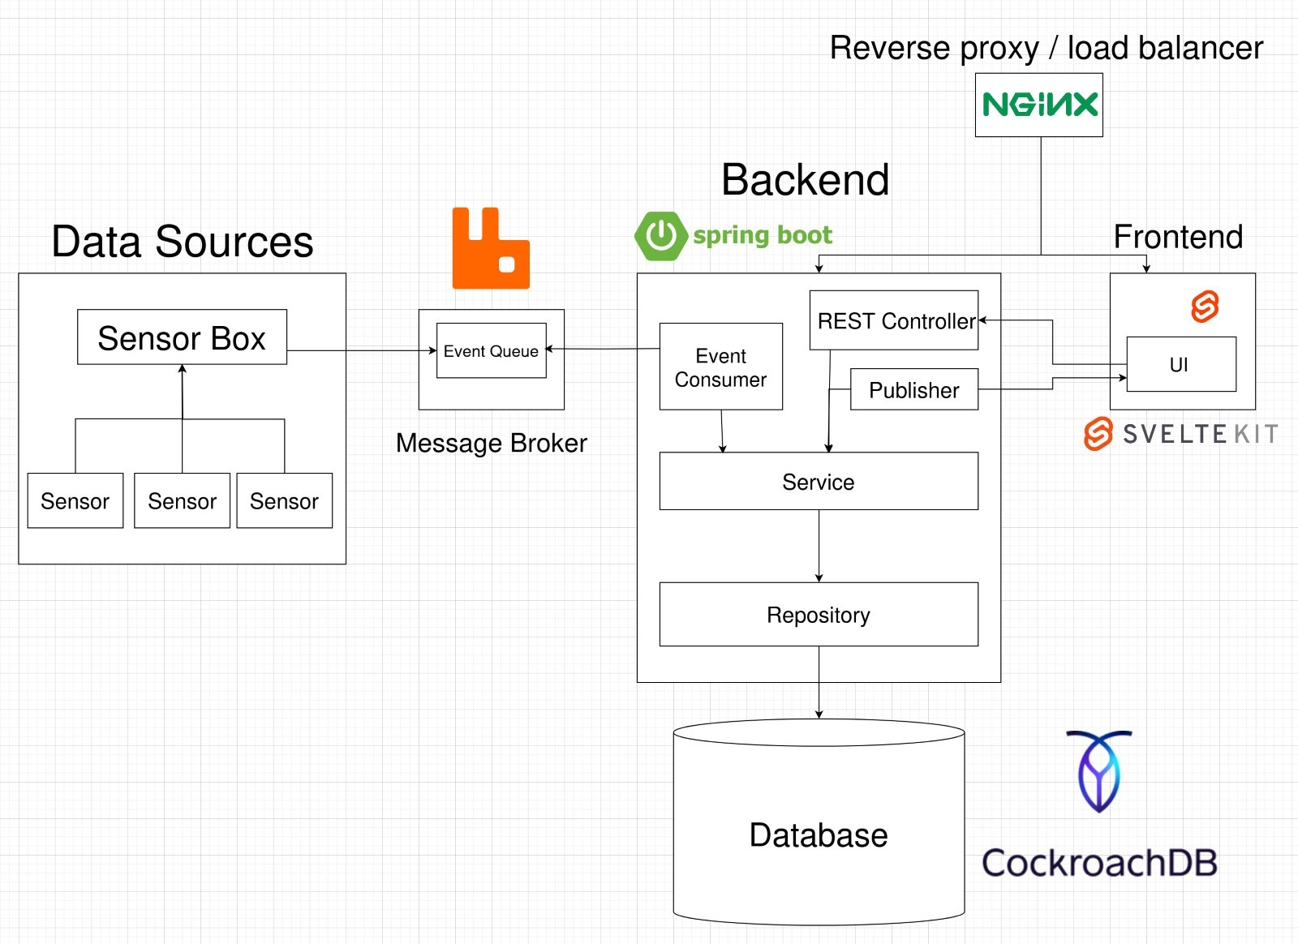
Architecture

Slide 8
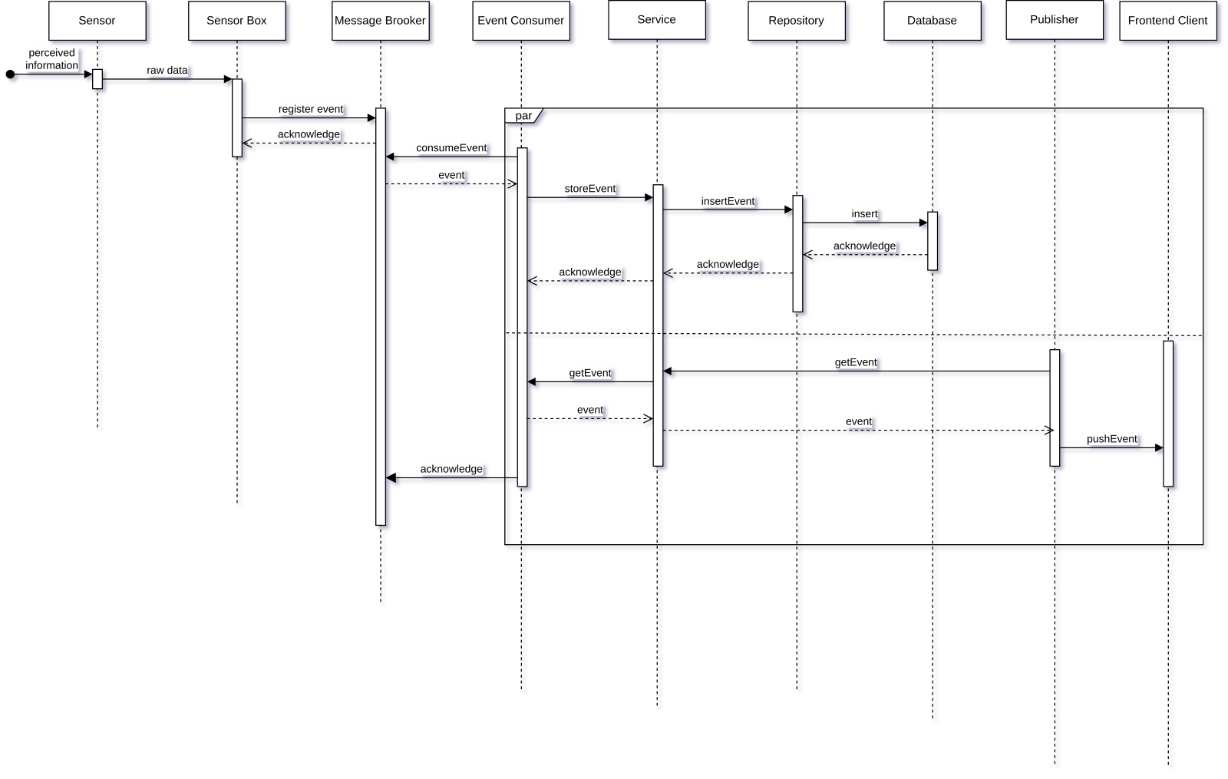
Module interactions

Slide 9

Agile Practices
Work divided in several sprints
Scrum
Backlog
Feature Driven WorkFlow
Weekly meetings

Slide 10
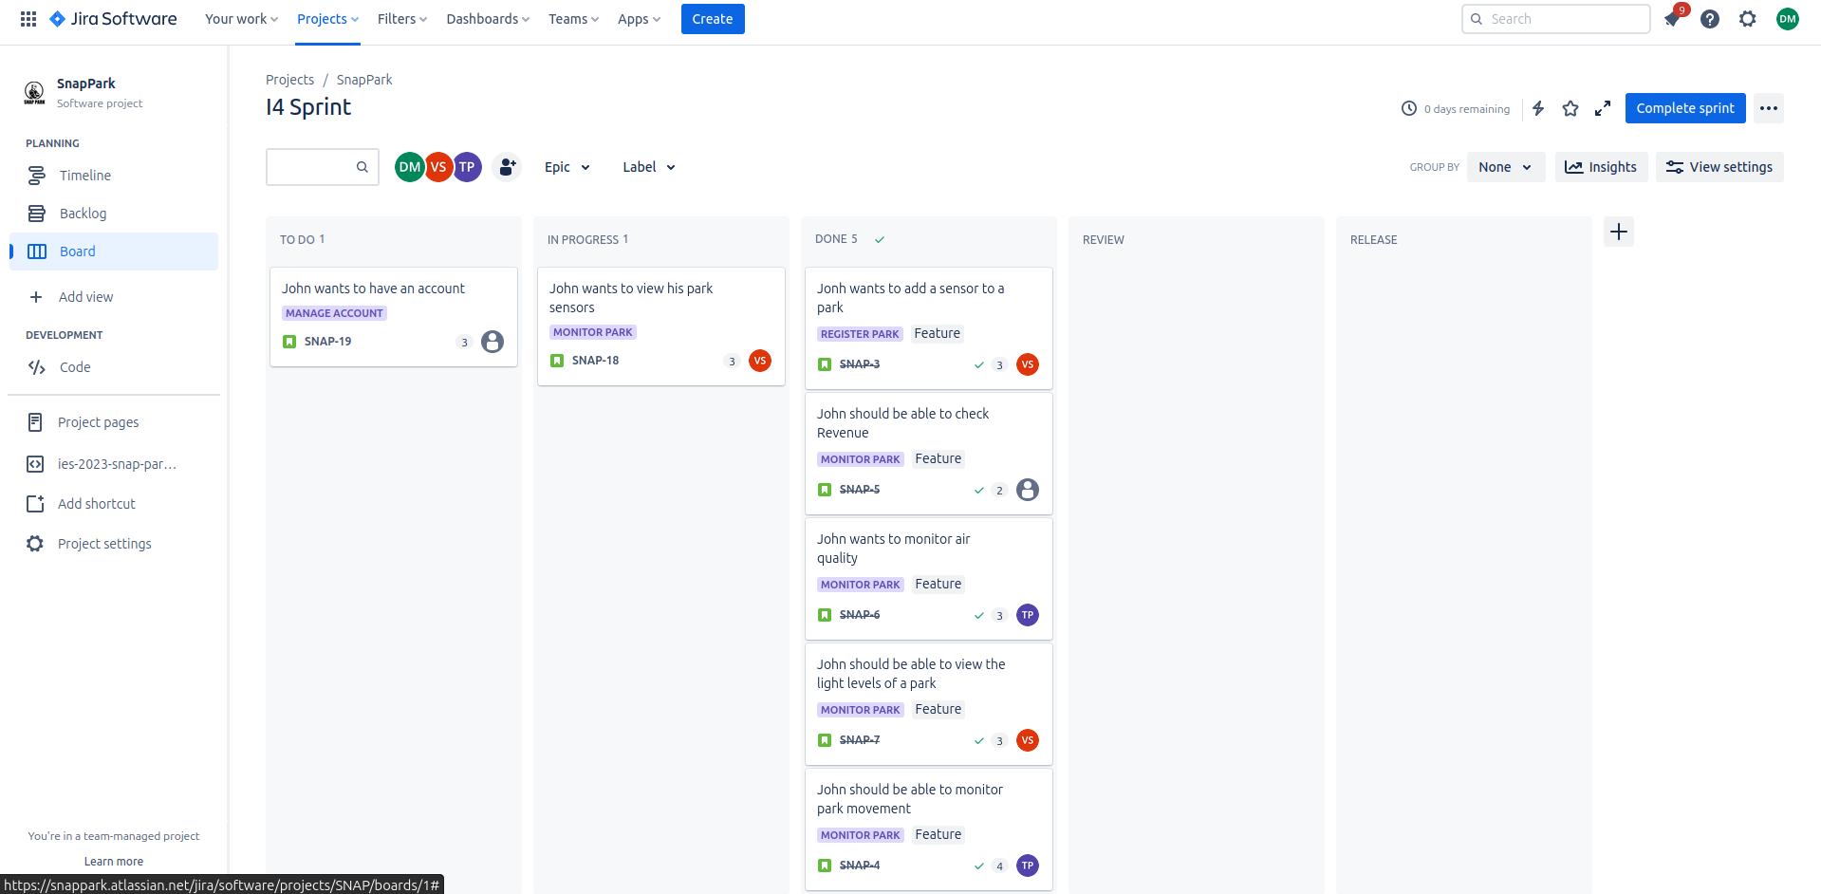
Product Backlog and Prioritization:

Slide 11

Demo and Showcase of the App

Slide 12
Thanks

